Slide 1
Social Software Testing Approaches
Maaret Pyhäjärvi

Slide 2
What Social at Work Usually Looks Like
Planning
PI Planning
Sprint Planning
Backlog Refinement
Three Amigos Sessions
Daily Meetings
Hallway Whiteboarding
Doing ???
Traditional Pair Testing
Strong-Style Pair Testing
Ensemble (Mob) Testing
Bug Bashes
GenAI Pair Testing
Notes:
1.00 – 4:00
https://bbst.courses/blog/social-software-testing-approaches/

Slide 3
Why?
Co-generate options
Choose to try, choose through doing
Practice (doing) over theory (plan)
Avoid ping-pong
Timely feedback
Build more skilled empathetic colleagues
Notes:
4:00-6.24

Slide 4
Resistance!
Notes:
6:24-7:46

Slide 5
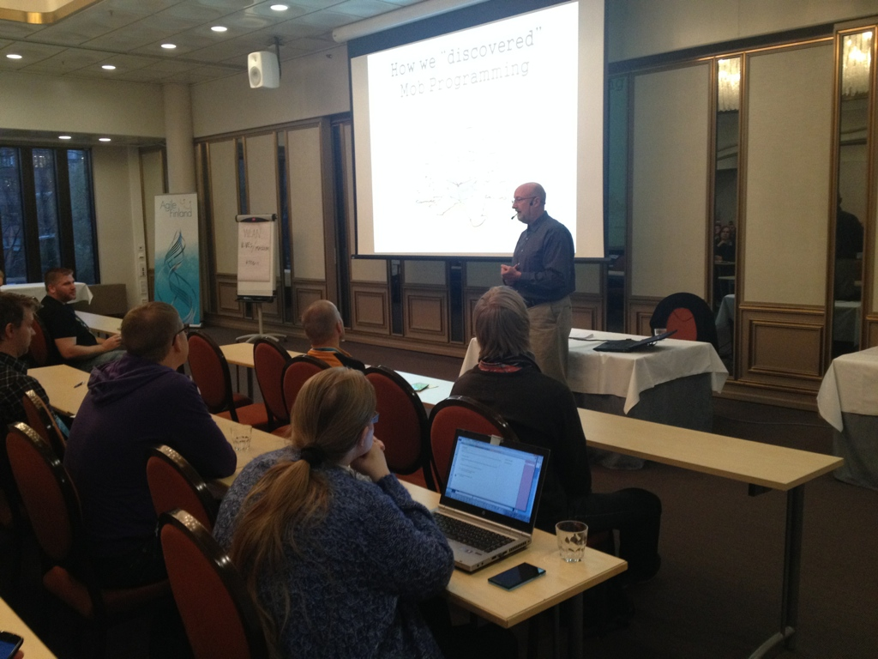
A talk on a strange idea:
Mob Programming
Notes:
7:46-8:48

Slide 6
“A ridiculous idea - I need to experience it 1st hand”
Notes:
8:48-10:30

Slide 7
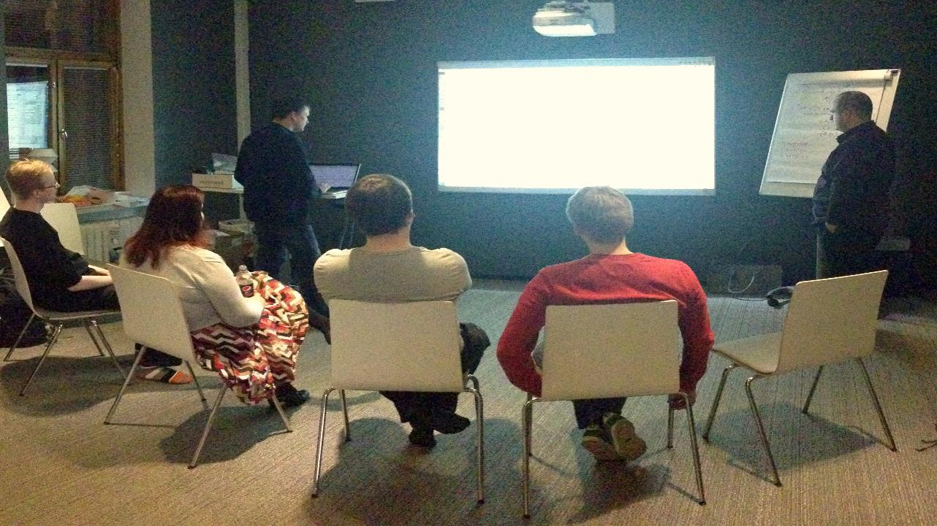
Notes:
10:30-13:27

Slide 8
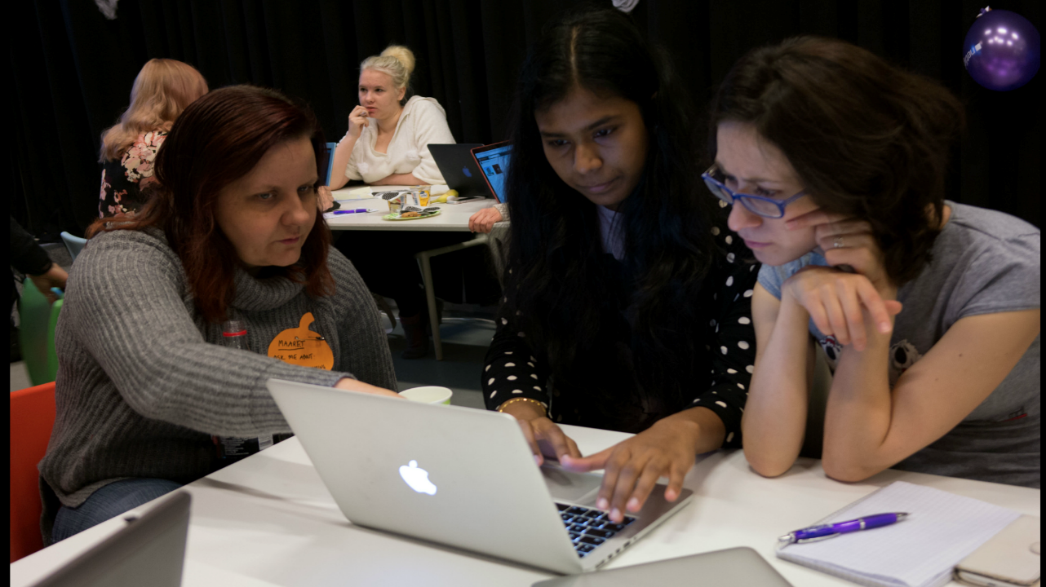
Notes:
13:27-14:02

Slide 9
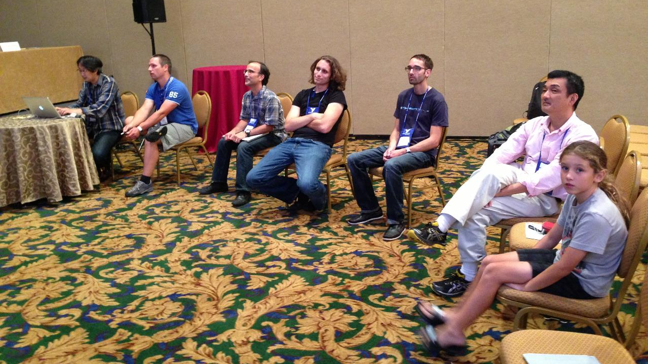
Notes:
14:02-14:37

Slide 10
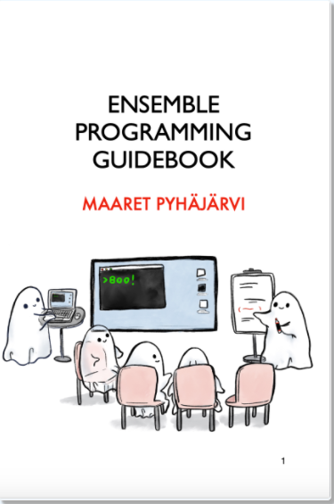
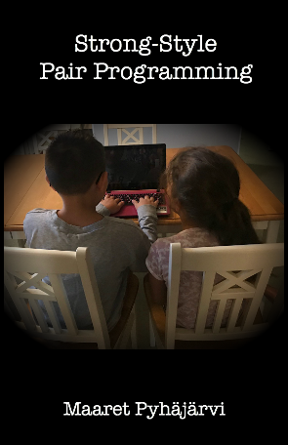
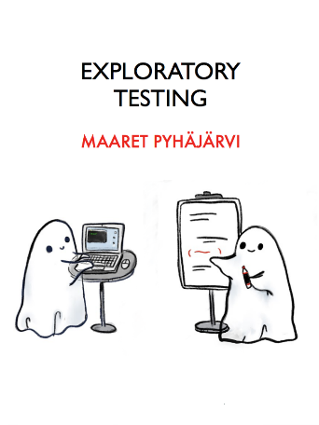
https://ensembleprogramming.xyz
https://strongstylepairprogramming.xyz
https://exploratorytesting.xyz
https://bbst.courses/blog/social-software-testing-approaches/
Notes:
14:37-14:59

Slide 11
Our Options
Notes:
15:10-16:05

Slide 12
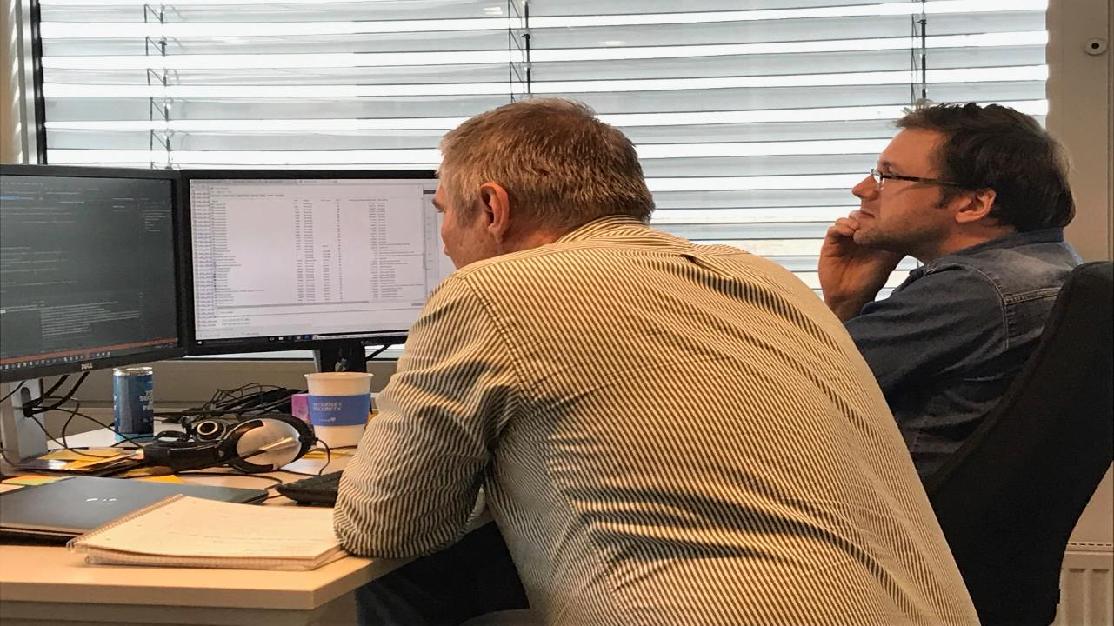
Notes:
16:05-19:09

Slide 13
Comparison
Traditional
Strong Style
I have an idea…
Give me the keyboard
I have an idea…
Please take the keyboard
Notes:
19:09-21:21

Slide 14
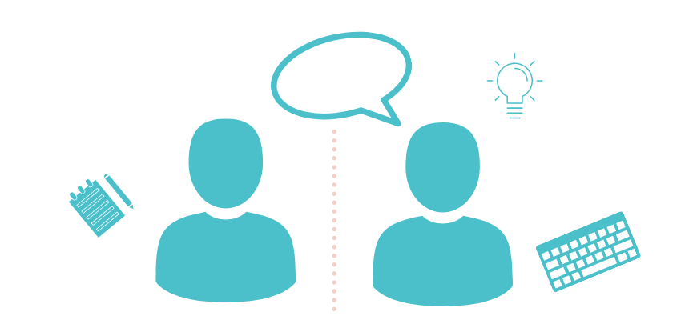
traditional pair testing
Notes:
21:21-23:47

Slide 15

Strong-style pair testing
Notes:
23:47-26:29

Slide 16
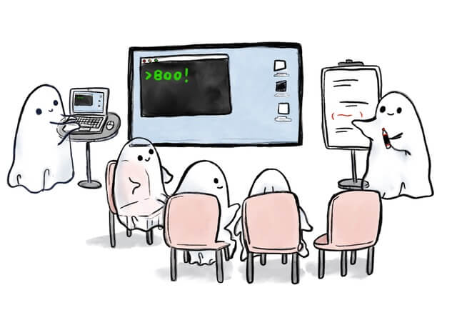
ensemble testing
Notes:
26:29-29:25
Driver – Navigator
Rotation
Retrospective
Group size

Slide 17
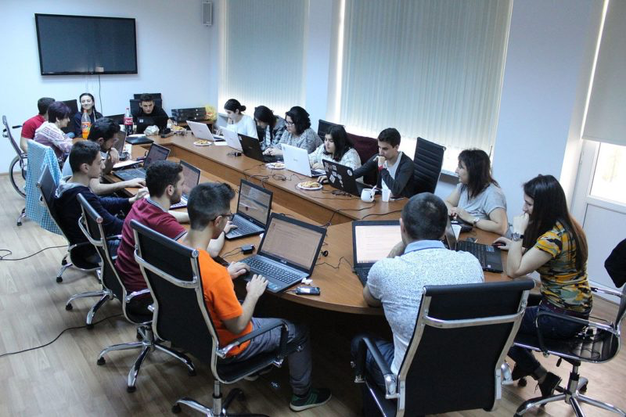
bug bashes
Image from: https://conorfi.com/software-testing/guidelines-for-running-a-bug-bash/
Notes:
29:33-32:02

Slide 18
Making Your Choices
Approach | Best Used For
Traditional Pair Testing | Working together in an equal pair requiring little rule assistance.
Strong-Style Pair Testing | Working together in an unequal pair.
Ensemble Testing | Learning and innovating a shared way of working.
Bug Bashes | Seeing problems from many perspectives.
Notes:
32:02-34:37

Slide 19
Social Testing Approaches are Great For
Larger organizations where functional silos continue to exist (Testers get together to test)
Agile teams where we need to share testing skills (Teams get together to test)
Teaching anything testing related to a group (Training group gets together to test)
Introducing testing perspectives to programming activities (Testers joining ensemble programming)
Notes:
34:37-36:36

Slide 20
Social Software Testing Approaches on Tour
From healing my loneliness
To Lisi Hocke’s testing tours
To many people on tour
None of this new style of deep, serendipitous learning would be possible without the social software testing approaches
Notes:
36:36-38:36

Slide 21
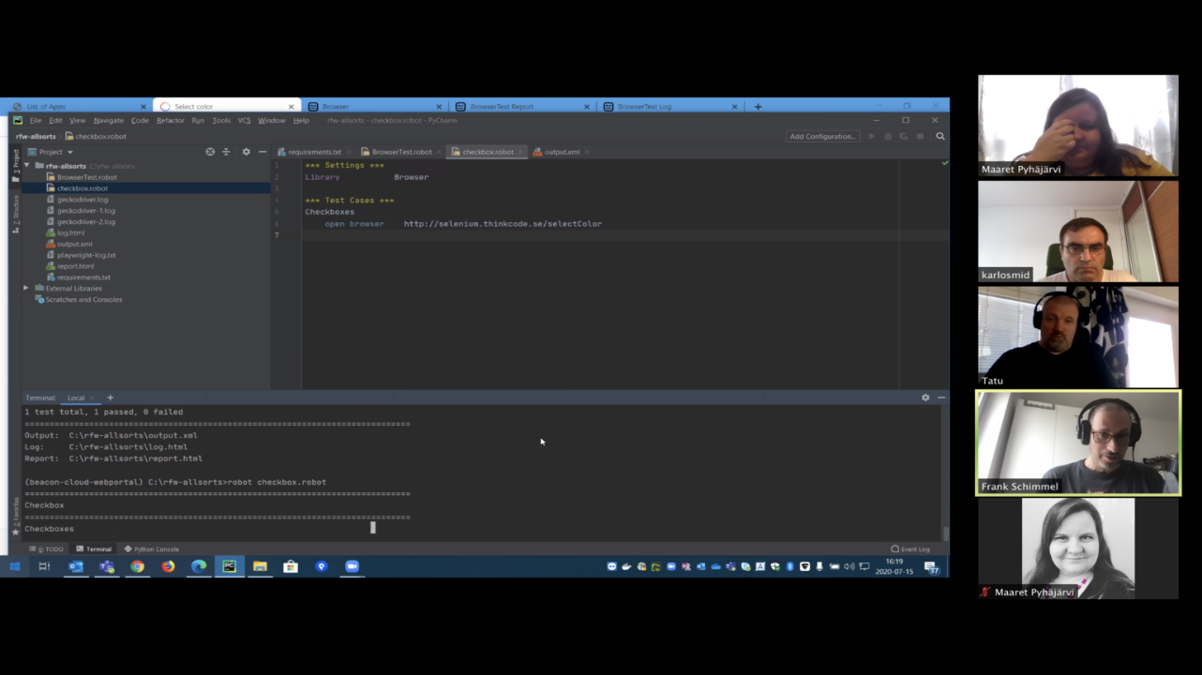
Robot Framework Browser Library in July 2020: Maaret, Frank, Karlo, Tatu
Notes:
38:36-39:20

Slide 22
Learning or Contributing
Notes:
39:20-40:01

Slide 23
Accidental Learning by being Intentional about Learning
Notes:
40:01-40:39
Figure out what goes where

Slide 24
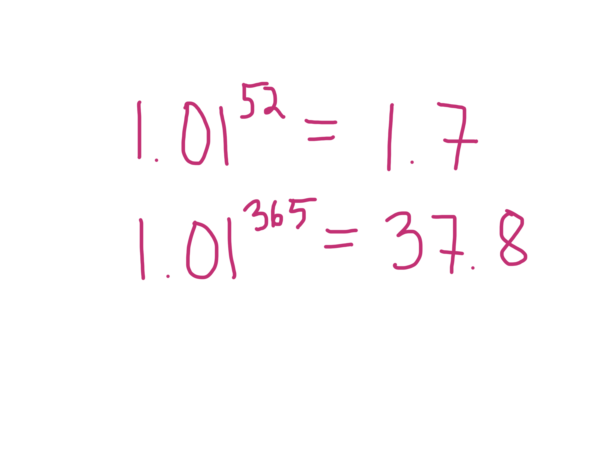
Notes:
40:39-41:20

Slide 25
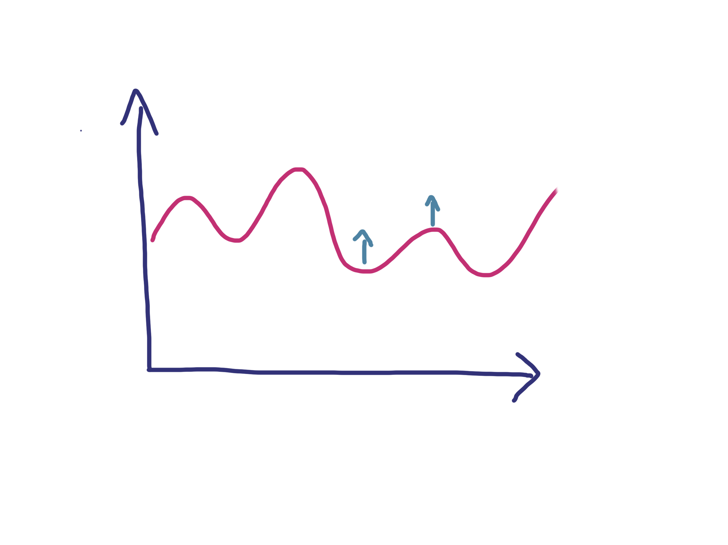
Notes:
41:20-41:50

Slide 26
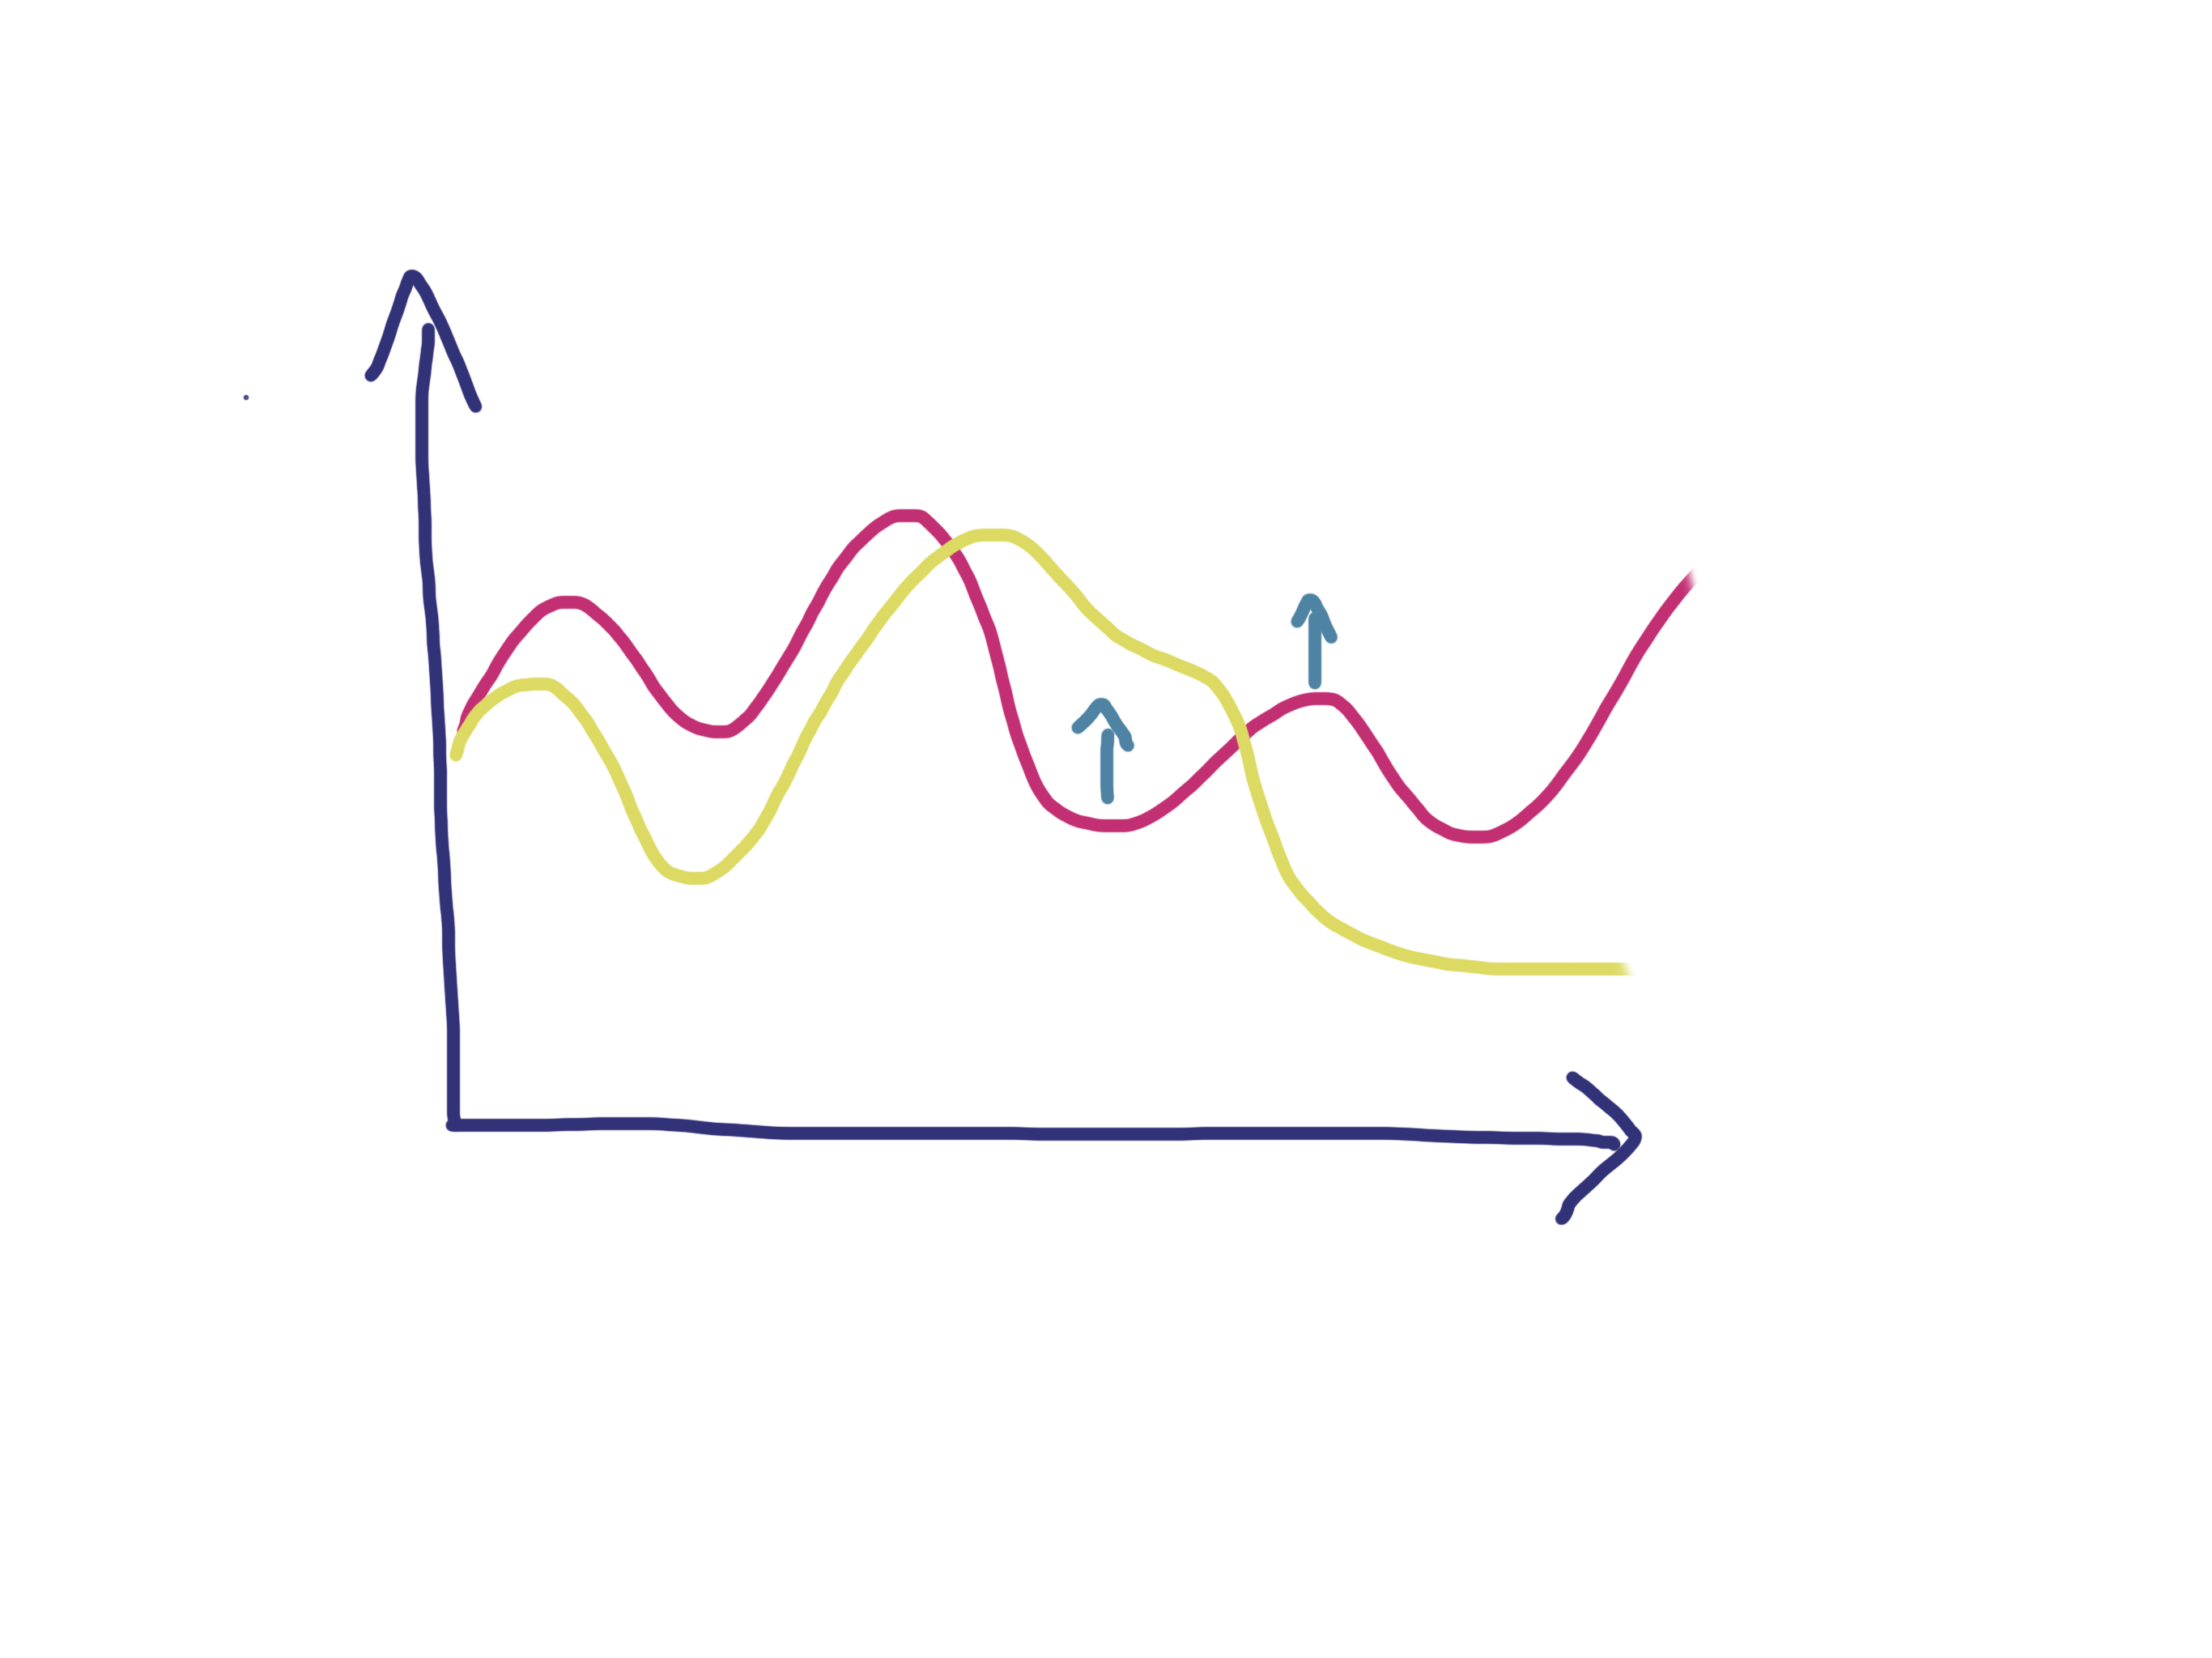
Notes:
41:50-42:20

Slide 27
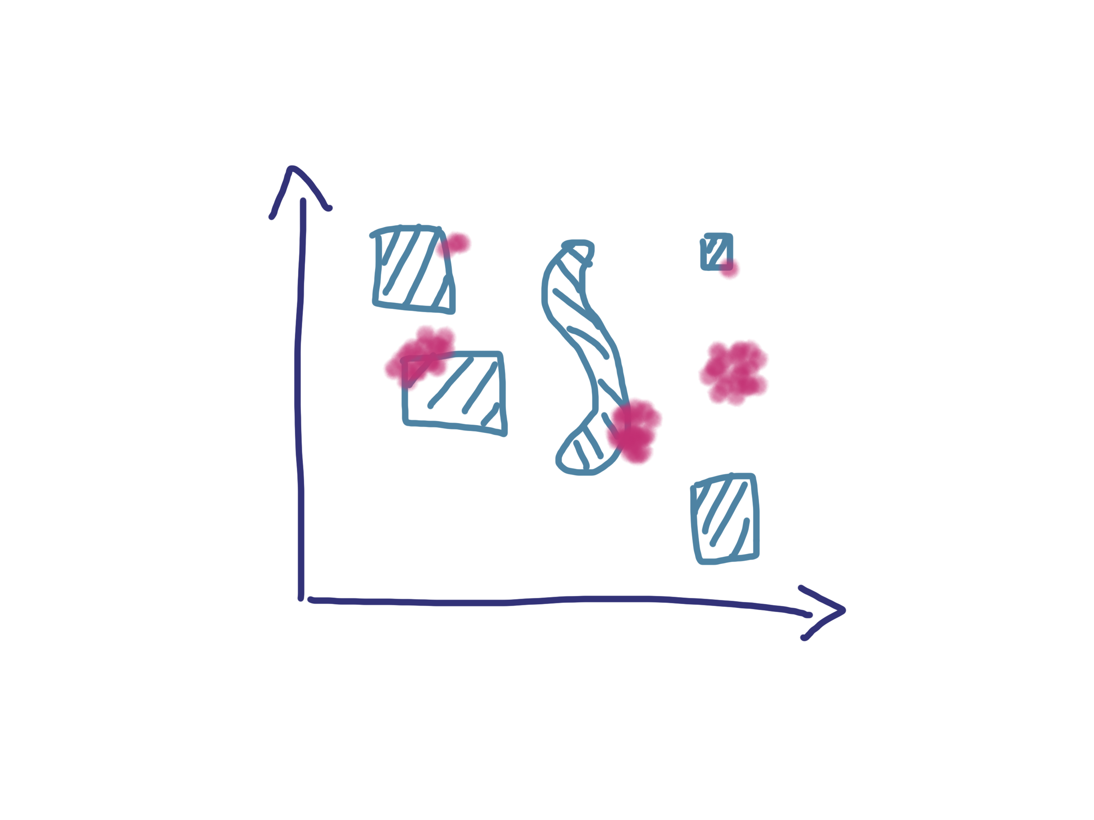
Notes:
42:20-42:53

Slide 28
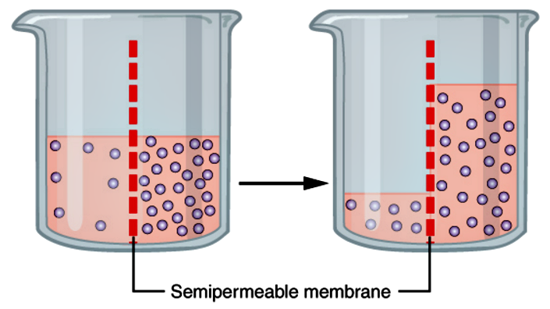
Learning Through Osmosis
Notes:
42:53-43:22
Osmosis is a process that does not require energy.

Slide 29

GenAI Pair Testing

Slide 30
I had great ideas even when I did not know how to turn them into code – removing the distance is worth the struggle.
Notes:
43:22-43:42

Slide 31
When developers like each other, code review is known as pair programming.
Notes:
43:42-44:11

